Slide 1
Project title: „E(uropean) V(oluntary) S(ervise) as P(lanning)A(nalizing)P(ractising)E(valuateing)R(epeating) for life“ Project number: 2016-3-EE01-KA105-034547
Estonia
2018 summer
01.07-30.07.2018

Slide 2
Who?
Lithuania, NGO Actio Catholica Patria
Spain, Coordinadora Infantil y Juvenil de Tiempo Libre de
Vallecas
Latvia, Jaunatne par
Italy, Associazione di volontariato P.E.CO. Progetti
Europei di Cooperazione
Italy, Associazione Culturale LINK
Estonia, NGO Öökull

Slide 3
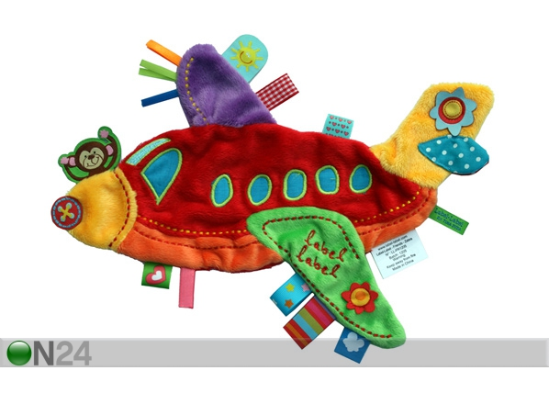
30.6.2018 Arrival
By plane to
Riga (Latvija) or Tallinn (Estonia) Airport
By bus to
Pärnu Bus Station

Slide 4
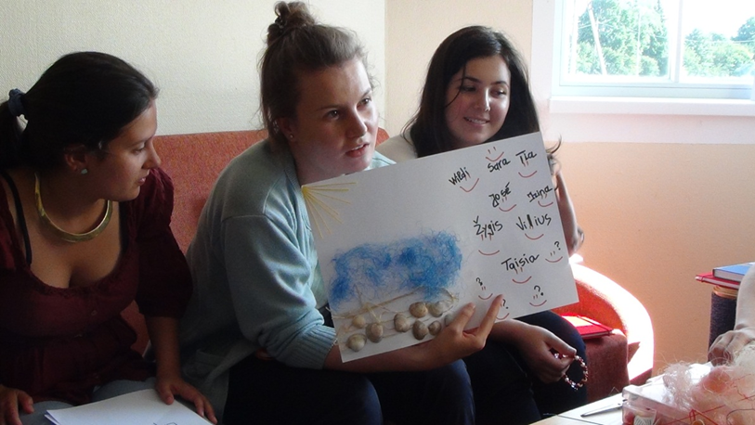
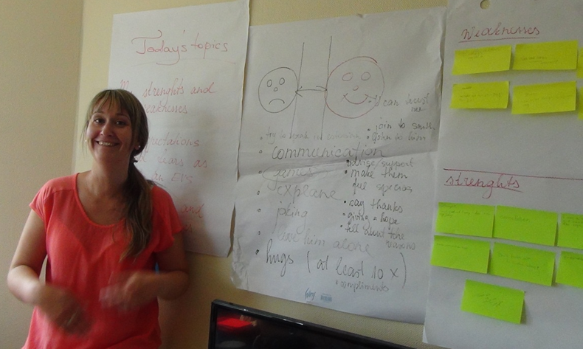
01.07.2018 On-arriving training
Get know each other “Who I am?”
My expectations and fears – collage, adventure methods
My weakness and my intensity
Intercultural learning and creative experience
Introduction of the organisation (Öökull), the project and team
Introduction of Youth in Action programm
Overview of the project
Tasks and responsibilities of the volunteers. Challenges
What is Youthpass and how to deal it?
Learning goals in the EVS
Intoduce the Captain Diary
Cultural evening

Slide 5
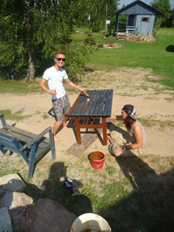
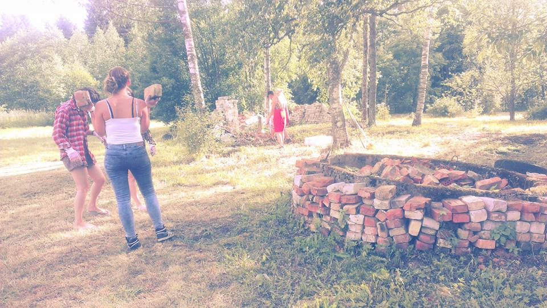
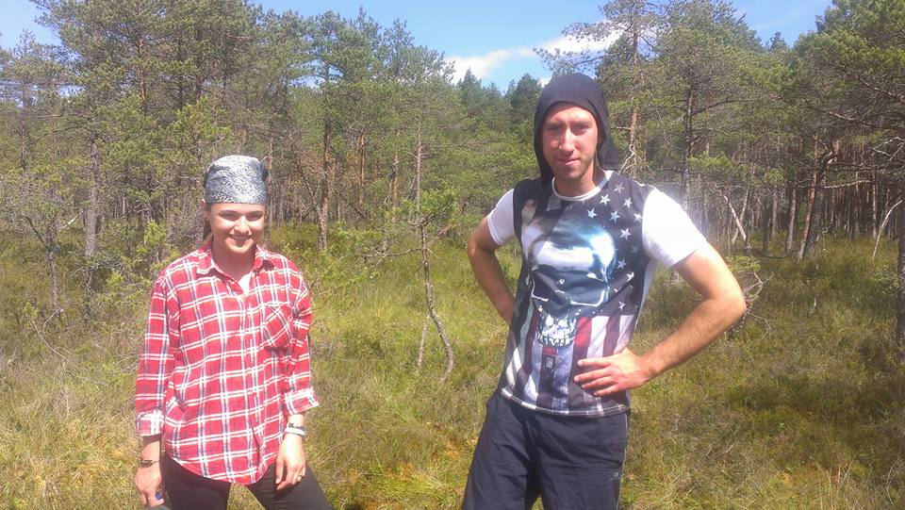
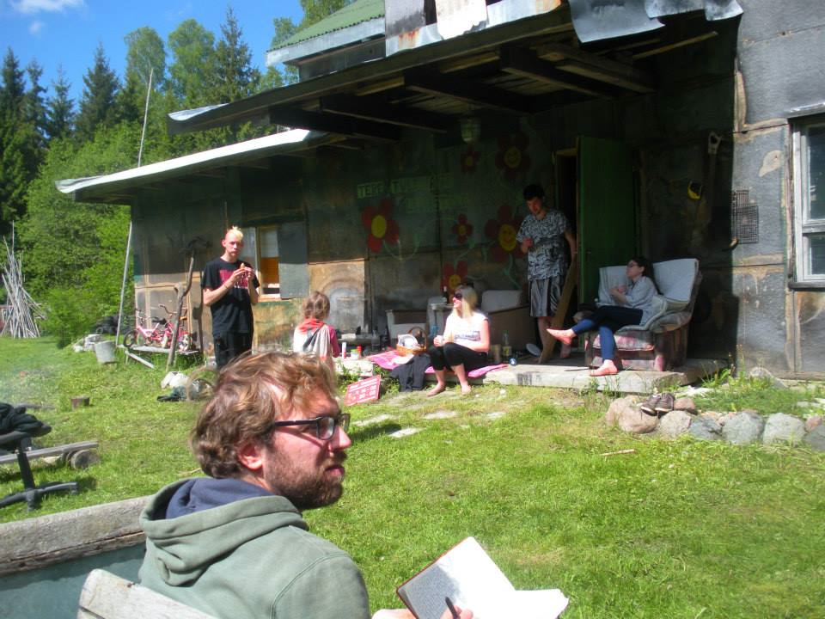
2.-7.07.2018 Ecofarming in Pärnu county
It is rural place in Pärnu County 17 km from town. Calm and mysterical place for stay without internet and electricity.
The tasks of the volunteers:
Learning simple building skills
Learning gardening skills
NB! A lot of possibilities to design and practise own ideas in farming☺

Slide 6
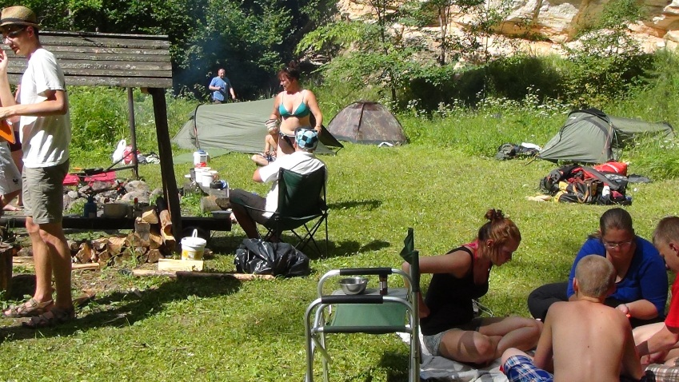
9.-13.07.2018 Phonix´s trekking
6-days trekking in Southern-Estonia
During this trekking volunteer´s task is to be the support person for 12-16 years-old youngsters with beheviour problems.
The tasks of the volunteers:
To keep the youngsters as team to organize cooking, camping, motivating themselves

Slide 7
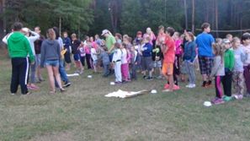
25.-30.07.2018 Adventure Youth camp in Nursipalu military camp
Participants are 60 youngsters in age 8-14
The tasks of the volunteers:
To organize free time activities and competitions
To assist the group leaders
To help in kichen panel

Slide 8
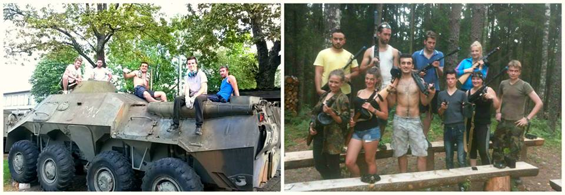
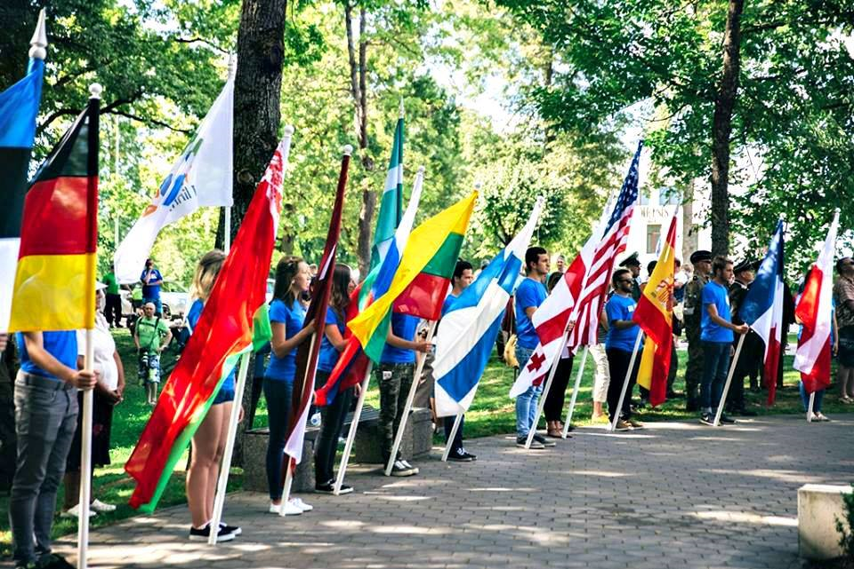
23.-28.07.2018 Military festival in Valga
Living in the hostel http://www.isamaalinemuuseum.ee/teenused/puhkus-naril/
This festival introduces history of military in Europe, there is staged historical battles
The tasks of the volunteers:
to prepare the festival: cleaning and paiting the military technics; creating and renovating the requisites etc
to carry out activities in festival: representing your country in the procession, participating in security team, helping to carry out the stagings of the battles

Slide 9
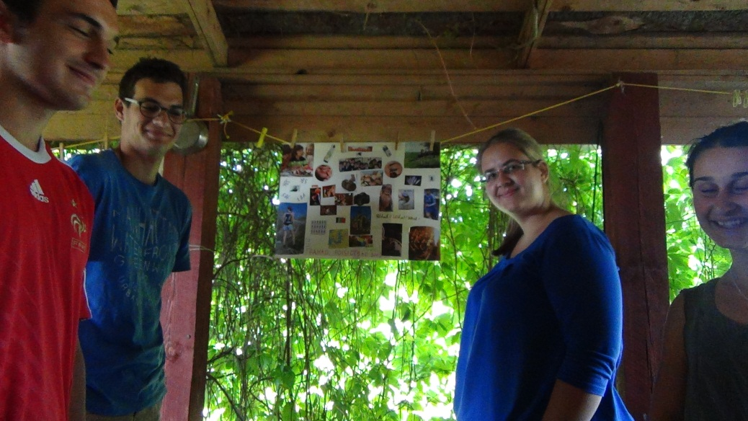
30.07.2018 Evaluation
Place: Kuuste
Outcomes:
Summary and reflection of activities
Individual plan for future
Youthpass
Volunteer´s report

Slide 10
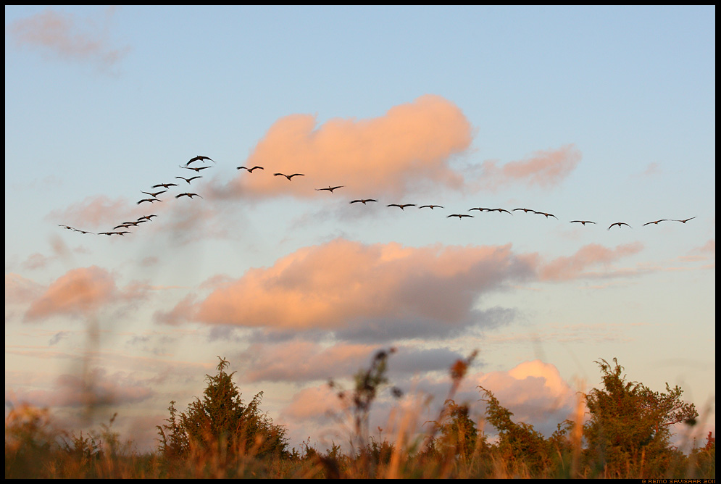
Leaving
31.07.2018

Slide 11
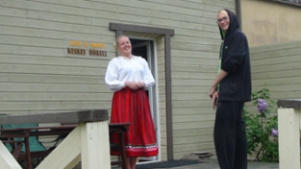
Contacts:
Mrs Ly Brikkel, project manager
Lii.Brikkel@mail.ee
mob: +372 5646 4679
Mrs Jane Rumask, mentor
janerumask@gmail.com
mob: + 372 5657 1995

